Slide 1

IT Risk Management
Bertrand VANDENBULCKE- Group-IT, VP Management & Control Paris, 2015 November 18th

Slide 2
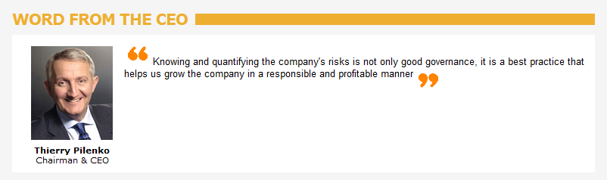
IT Risk Management
A Group requirement : Include the IT risk inside the TECHNIP Risk Management System,
Notes:
Discipline = le management de l’IT Program & Project Portfolios ou = davantage de discipline dans nos process ?? Désolée par clair pour moi

Slide 3

IT Risk IN GENERAL
3
Footer can be customized

Slide 4
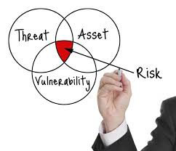
IT Risk Management
The measure of an IT risk can be determined as a product of threat, vulnerability and asset values
Notes:
Discipline = le management de l’IT Program & Project Portfolios ou = davantage de discipline dans nos process ?? Désolée par clair pour moi

Slide 5

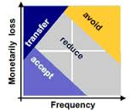
IT Risk Management
The process of risk management is an ongoing iterative process.
The business environment is constantly changing and new threats and vulnerability emerge every day.
The choice of countermeasures used to manage risks must strike a balance between productivity, cost, effectiveness of the countermeasure, and the value of the asset being protected.
Notes:
Discipline = le management de l’IT Program & Project Portfolios ou = davantage de discipline dans nos process ?? Désolée par clair pour moi

Slide 6
IT Risk Management
Two IT Risks Management approaches:
Intrinsis IT Risks: Permanent IT Risks currently managed under our IT operational processes
Extrinsis IT Risks: Temporary IT Risks linked to a specific event like company acquiring, Technip building move, Specific business projects requirements,..
Notes:
Discipline = le management de l’IT Program & Project Portfolios ou = davantage de discipline dans nos process ?? Désolée par clair pour moi

Slide 7
Intrinsic IT Risk Management Tool
7
Footer can be customized

Slide 8

Intrinsic IT Risk Management Tool
Intrinsic IT Risk Assessment:
Based on an Excel file
Assessment Period:
Permanent: What are permanent risks to prevent the delivery of IT services?.
4 Sheets:
Intrinsic IT Risk Presentation: to present the tools and assessment referential
Risk Assessment: to assess the criticality of IT risks (From Deloitte IT risk catalog, based on severity and probability)
Mapping: to present the cartography of assessed IT risks
Risk Criticality Matrix: GOPS 18001 Assessment referential
Notes:
Discipline = le management de l’IT Program & Project Portfolios ou = davantage de discipline dans nos process ?? Désolée par clair pour moi

Slide 9
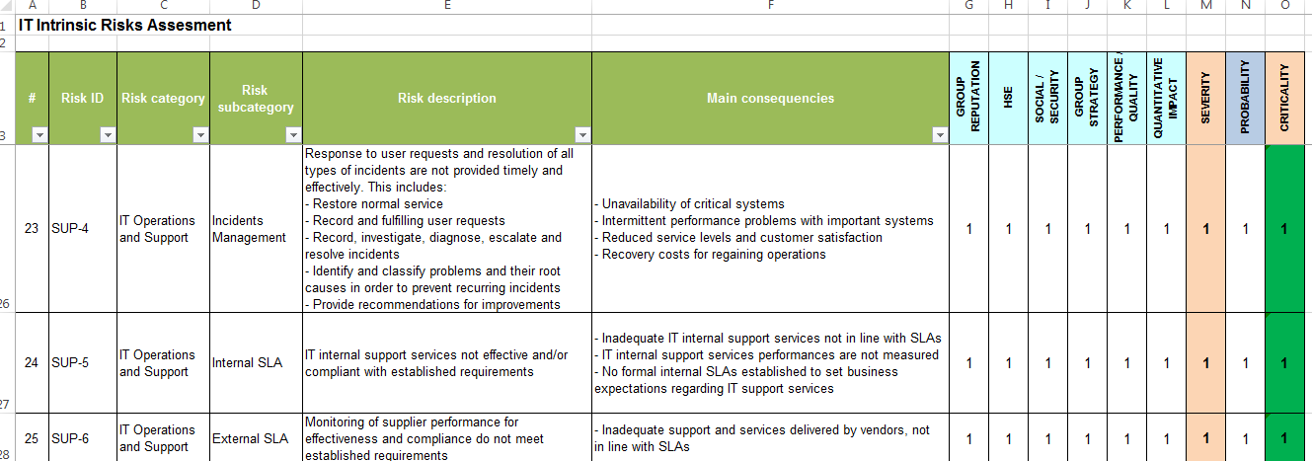
Extrinsic IT Risk Management Tool: IT Risk Assessment
From the Deloitte IT Risk catalog, for each IT risk:
Category and sub-category of the risk
Description of the risk
Main consequences
Severity assessment
Probability that the risk happens.
These assessed IT risks are the basis of the TECHNIP IT part of the Internal Control.
Definition of the Risk/Control Matrix
Design of Controls
Tests,
Action Plan
Notes:
Discipline = le management de l’IT Program & Project Portfolios ou = davantage de discipline dans nos process ?? Désolée par clair pour moi

Slide 10
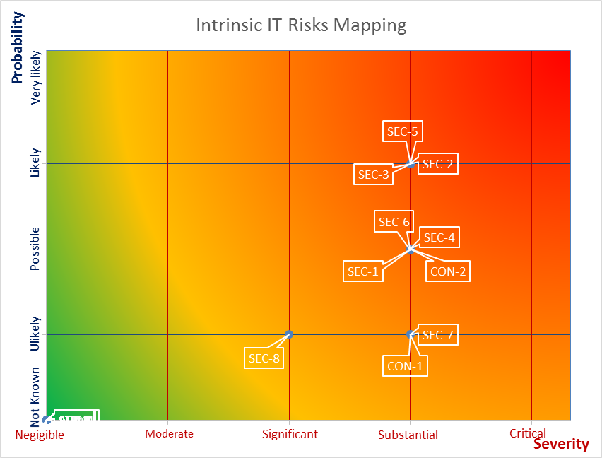
Extrinsic IT Risk Management Tool: IT Risk Mapping
Helping to define mitigation priorities and to measure the IT risk evolution
Notes:
Discipline = le management de l’IT Program & Project Portfolios ou = davantage de discipline dans nos process ?? Désolée par clair pour moi

Slide 11
Extrinsic IT Risk Management Tool
11
Footer can be customized

Slide 12

Extrinsic IT Risk Management Tool
IT Risk identification & Assessment template:
Based on an Excel file
Assessment Period:
Previous Quarter: Did the risk occur? or could have happened?.
Current Quarter: Which specific event could affect the Information System?
3 Sheets:
IT Risk Questionnaire: to identify major events which could affect the Information System generating important impact for the Technip business
Major Risk Assessment: to assess the criticality on business of identified major IT risks (based on severity and probability)
Risk Criticality Matrix: GOPS 18001 Assessment referential
Notes:
Discipline = le management de l’IT Program & Project Portfolios ou = davantage de discipline dans nos process ?? Désolée par clair pour moi

Slide 13
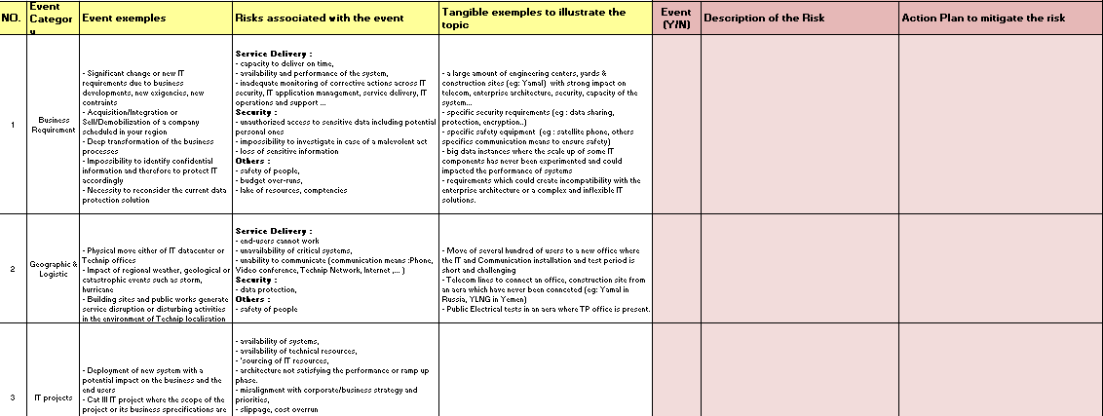
IT Risk Management Tools: IT Risk Questionnaire
Identify events which could impact :
Business Requirements
Geographic & Logistic (users buildings, datacenters…)
IT Project development
Information Technology issues
Human Resources
IT Security
Notes:
Discipline = le management de l’IT Program & Project Portfolios ou = davantage de discipline dans nos process ?? Désolée par clair pour moi

Slide 14
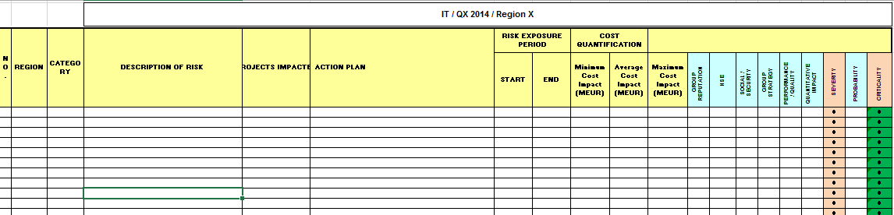
IT Risk Management Tools: IT Major Risk Assessment
Following the Group Risk Management recommendation, for each identified major IT risk:
Description of the risk
Business Projects impacted
Action Plan to avoid or mitigate the risk
Risk exposure period
Cost quantification (if valuated)
Severity assessment
Probability that the risk happens.
Notes:
Discipline = le management de l’IT Program & Project Portfolios ou = davantage de discipline dans nos process ?? Désolée par clair pour moi

Slide 15
IT Risk Management Methodology
15
Footer can be customized

Slide 16
IT Risk Management Methodology (based on ISO 27005)
Context Establishment
legal and regulatory requirements
strategic value for the business of information processes
stakeholder expectations
negative consequences for the reputation of the organization.
Risk Assessment
Risk analysis
Risk Identification
Risk estimation
Risk evaluation
Risk Treatment (Mitigation)
Identify risk response options
Respond to discovered risk exposure and opportunity
 Reduce ; Retain ; Avoid ; Transfer
Notes:
Discipline = le management de l’IT Program & Project Portfolios ou = davantage de discipline dans nos process ?? Désolée par clair pour moi

Slide 17
IT Risk Management Methodology (based on ISO 27005)
Risk Acceptance
Accept IT risk
Risk Communication
Promote IT risk-aware culture
Encourage effective communication of IT risk
Develop IT risk indicators.
Risk monitoring and review
Integrate with Corporate Risk Management.
Perform a peer review of IT risk analysis.
Provide independent assurance over IT risk management
Notes:
Discipline = le management de l’IT Program & Project Portfolios ou = davantage de discipline dans nos process ?? Désolée par clair pour moi

Slide 18
IT Risk Management Process
Interface to other operational processes
Corporate
Risk Management
Strategy
Risk Assessment
Risk Treatment
Definition of Scope and framework for the management of risks
Risk analysis
Risk Identification
Risk estimation
Risk evaluation
Identification of options
Action plan
Residual risk identification
Gops 18001
Risk Communication
Risks Awareness
Consulting
Risk
Acceptance
Monitor and Review

Slide 19
IT Risk Organizational Process
Corporate
Risk Management
Strategy
Corporate Risk Manager
Review
Level 4
ITMC
Group IT Risk
IT Risk Mgr
Review
Level 3
Risk Communication
Risks Awareness
Consulting
Risk
Evaluation
Region Risk
Mgr
Business
Domains
Owners
Monitor and Review
Review
Level 1
Review
Level 1
Reviews
Level 2
IT Systems / Business Risks
Identification
& Estimation
IT-SSO
Major IT risks
IT Systems/Business Risks
Identification
& Estimation
Technology Risks
Identification & Estimation
IT Projects
IT
Region
IT
Operations
Group Security
Mgr
Review
Level 1
IT Security Risks
Identification
& Estimation
IT Risk treatment
Notes:
Discipline = le management de l’IT Program & Project Portfolios ou = davantage de discipline dans nos process ?? Désolée par clair pour moi

Slide 20
IT Risk : Roles & Responsibilities
Strategy
OPPORTUNITY
Service Design
Service Transition
Service Operation
IT Risk Client Management & Local Services RACI
1
IT Risk Opportunity Phase RACI for IT Business projects
2
IT Risk Opportunity Phase RACI for IT Technical projects
3
IT Risk Business Systems Design Phase RACI
4
Major
Risks
IT Risk Technology Systems Design Phase RACI
5
Major Risks
IT Risk Operation Phase RACI
Major Risks
6
Major Risks
Global IT Risk RACI
7
TECHNIP Risk Management
RACI = Responsible Accountable Consulted Information
Notes:
20

Slide 21
IT Risk : RACI Matrix key actors
Enterprise
Role to be developed
IT Organization
Group IT
Risk
Mgr
IT Applications
& Services
IT
Enterprise
Architect
IT
Operations
Corp.
Risk
Mgr
Business
Domain
Owner
CISO
(Global) IT
Operation
Mgr
IT
Application
Owner
(Global ) IT Delivery
Mgr
IT Business
Domain Mgr
ITD
IT
Project
Mgr
CTO
Region
Risk Mgr
Group
Security Mgr
Notes:
21

Slide 22
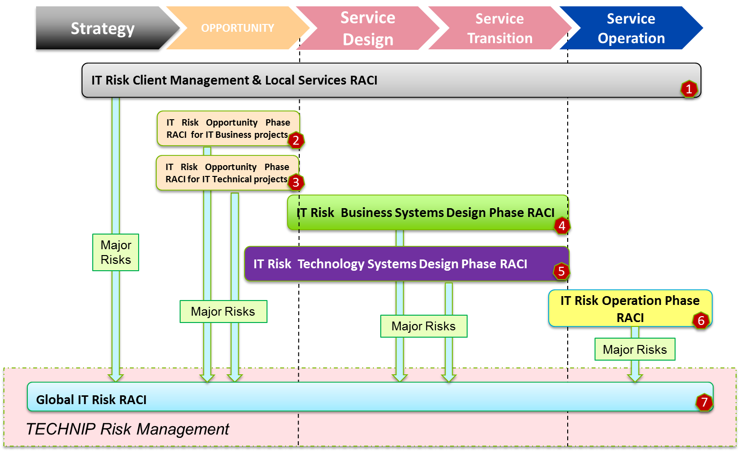
IT Risk Client Management & Local Services RACI
1
IT Risk Client Management & Local Services RACI | Corporate Risk Mgr | Group IT Risk Mgr | IT Enterprise Architect | IT Application owner | IT Project Mgr | IT Business Domain Mgr | Business Domain Owner | (Global) IT Delivery Mgr | (Global) IT Operation Mgr | CTO | ITD | Regional Risk Mgr
IT Risk Identification |  |  |  |  |  |  |  |  |  |  | A/R
IT Risk Estimation |  |  |  |  |  |  |  |  |  |  | R | A
IT Risk Evaluation |  | C |  |  |  |  |  |  |  |  | A/R | C
Acceptance Risk |  |  |  |  |  |  |  |  |  |  | R | A
IT Risk Treatment (mitigation) |  |  |  | C |  |  |  | C | C | C | A/R
IT Risk Communication |  | I |  | I |  | I |  |  |  | I | A/R | I
IT Risk Monitoring and Review |  | I |  |  |  |  |  |  | C |  | A/R
R = Stakeholder Responsible for doing the work to achieve the assigned task and/or complete the deliverable
A = Stakeholder ultimately Accountable for the correct and thorough completion of the task or deliverable
C = Stakeholder who is Consulted for opinion/input/contribution
I = Stakeholder who is Informed in order to be kept up to date with progress or completion of task
Risk example: end-users cannot work or unavailability of critical systems further to a physical move either of IT datacenter or Technip offices
Notes:
Discipline = le management de l’IT Program & Project Portfolios ou = davantage de discipline dans nos process ?? Désolée par clair pour moi

Slide 23
IT Risk Opportunity Phase RACI IT Business Projects
2
IT Risk Opportunity Phase RACI IT Business Projects | Corporate Risk Mgr | Group IT Risk Mgr | IT Enterprise Architect | IT Application owner | IT Project Mgr | IT Business Domain Mgr | Business Domain Owner | (Global) IT Delivery Mgr | (Global) IT Operation Mgr | CTO | ITD | Regional Risk Mgr
IT Risk Identification |  | C |  | A/R |  |  | C
IT Risk Estimation |  | C | C | R |  |  | A | I | C | C | C
IT Risk Evaluation | C | C |  | R |  | A | C |  | C | C | C
Acceptance Risk |  | I | I | R |  | I | A | I | I | I | I
IT Risk Treatment (mitigation) |  |  |  | A/R |  |  |  |  | C
IT Risk Communication |  | I | I | A/R |  | I |  | I | I | I | I
IT Risk Monitoring and Review |  | I |  | C |  | A/R |  |  | C
Risk example: Launch an IT project misaligned with corporate/business strategy and priorities
Notes:
Discipline = le management de l’IT Program & Project Portfolios ou = davantage de discipline dans nos process ?? Désolée par clair pour moi

Slide 24
IT Risk Opportunity Phase RACI IT Technical Projects
3
IT Risk Opportunity Phase RACI IT Technical Projects | Corporate Risk Mgr | Group IT Risk Mgr | IT Enterprise Architect | IT Application owner | IT Project Mgr | IT Business Domain Mgr | Business Domain Owner | (Global )IT Delivery Mgr | (Global) IT Operation Mgr | CTO | ITD | Regional Risk Mgr
IT Risk Identification |  | C |  |  |  |  |  |  |  | A/R
IT Risk Estimation |  | C | C |  |  |  |  | I | C | A/R | C
IT Risk Evaluation | C | C |  |  |  |  |  |  | C | A/R | C
Acceptance Risk |  | I | I |  |  |  |  | I | I | A/R | I
IT Risk Treatment (mitigation) |  |  |  |  |  |  |  |  | C | A/R | I
IT Risk Communication |  | I | I |  |  | I |  | I | I | A/R | I
IT Risk Monitoring and Review |  | I |  |  |  |  |  |  | C | A/R
Risk example: Launch a technical IT project based on an innovative solution with lack of maturity and reliability.
Notes:
Discipline = le management de l’IT Program & Project Portfolios ou = davantage de discipline dans nos process ?? Désolée par clair pour moi

Slide 25
IT Risk Design Phase RACI IT Business Systems
4
IT Risk Business Systems Design Phase RACI | Corporate Risk Mgr | Group IT Risk Mgr | IT Enterprise Architect | IT Application owner | IT Project Mgr | IT Business Domain Mgr | Business Domain Owner | (Global) IT Delivery Mgr | (Global) IT Operation Mgr | CTO | ITD | Regional Risk Mgr
IT Risk Identification |  |  |  | A | R
IT Risk Estimation |  |  | C | C | R | A | C | C | C | C | I
IT Risk Evaluation |  | C | C | C |  | A/R
Acceptance Risk |  | I | C | R |  | A | C
IT Risk Treatment (mitigation) |  |  |  |  | A/R |  |  |  | C | C
IT Risk Communication |  | I | I | I | R | A | I | I | I | I | I
IT Risk Monitoring and Review |  | I |  |  |  | A
Risk example: Financial impact linked to a consistent and important slippage of the delivery.
Notes:
Discipline = le management de l’IT Program & Project Portfolios ou = davantage de discipline dans nos process ?? Désolée par clair pour moi

Slide 26
IT Risk Design Phase RACI IT Technology Systems
5
IT Risk Technology Systems Design Phase RACI | Corporate Risk Mgr | Group IT Risk Mgr | IT Enterprise Architect | IT Application owner | IT Project Mgr | IT Business Domain Mgr | Business Domain Owner | (Global) IT Delivery Mgr | (Global) IT Operation Mgr | CTO | ITD | Regional Risk Mgr
IT Risk Identification |  |  |  |  | R |  |  |  |  | A
IT Risk Estimation |  |  | C |  | R |  |  | C | C | A | I
IT Risk Evaluation |  | C | C |  |  |  |  |  |  | A/R
Acceptance Risk |  | I | C |  |  |  |  |  |  | A/R
IT Risk Treatment (mitigation) |  |  |  |  | A/R
IT Risk Communication |  | I | I |  | R |  |  | I | I | A | I
IT Risk Monitoring and Review |  | I |  |  |  |  |  |  |  | A/R
Risk example: Design a technical solution which creates a long-term incompatibility with the enterprise architecture.
Notes:
Discipline = le management de l’IT Program & Project Portfolios ou = davantage de discipline dans nos process ?? Désolée par clair pour moi

Slide 27
IT Risk Operation Phase RACI
6
IT Risk Operation Phase RACI | Corporate Risk Mgr | Group IT Risk Mgr | IT Enterprise Architect | IT Application owner | IT Project Mgr | IT Business Domain Mgr | Business Domain Owner | (Global) IT Delivery Mgr | (Global) IT Operation Mgr | CTO | ITD | Regional Risk Mgr
IT Risk Identification |  |  |  | C |  |  |  | A | R | C | C
IT Risk Estimation |  |  |  | C |  |  |  | C | A | C | C
IT Risk Evaluation |  | C |  | C |  |  |  | C | A/R | C
Acceptance Risk |  |  |  |  |  |  |  |  | A
IT Risk Treatment (mitigation) |  |  |  | C |  |  |  | A/R | R | C
IT Risk Communication |  | I |  | I |  | I |  | A/R | C | I | I
IT Risk Monitoring and Review |  | I |  |  |  |  |  | A/R | C
Risk example: Failure to adopt and exploit new technologies in a timely manner.
Notes:
Discipline = le management de l’IT Program & Project Portfolios ou = davantage de discipline dans nos process ?? Désolée par clair pour moi

Slide 28
Global IT Risk RACI
7
Risk example: Risk to create local vulnerabilities which compromise the security of the information system.
Notes:
Discipline = le management de l’IT Program & Project Portfolios ou = davantage de discipline dans nos process ?? Désolée par clair pour moi

Slide 29
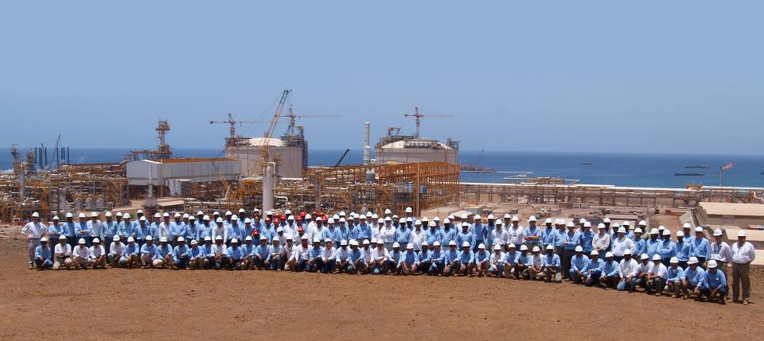
Thank you
www.technip.com

